Slide 1

TinkerCAD

Slide 2
Agenda
Overview of tool
Example
Activity

Slide 3
As we get started…
www.tinkercad.com
Free – Make a personal account if you don’t have one
Click on “Circuits” on the left side once you are in

Slide 4

Getting Started

Slide 5
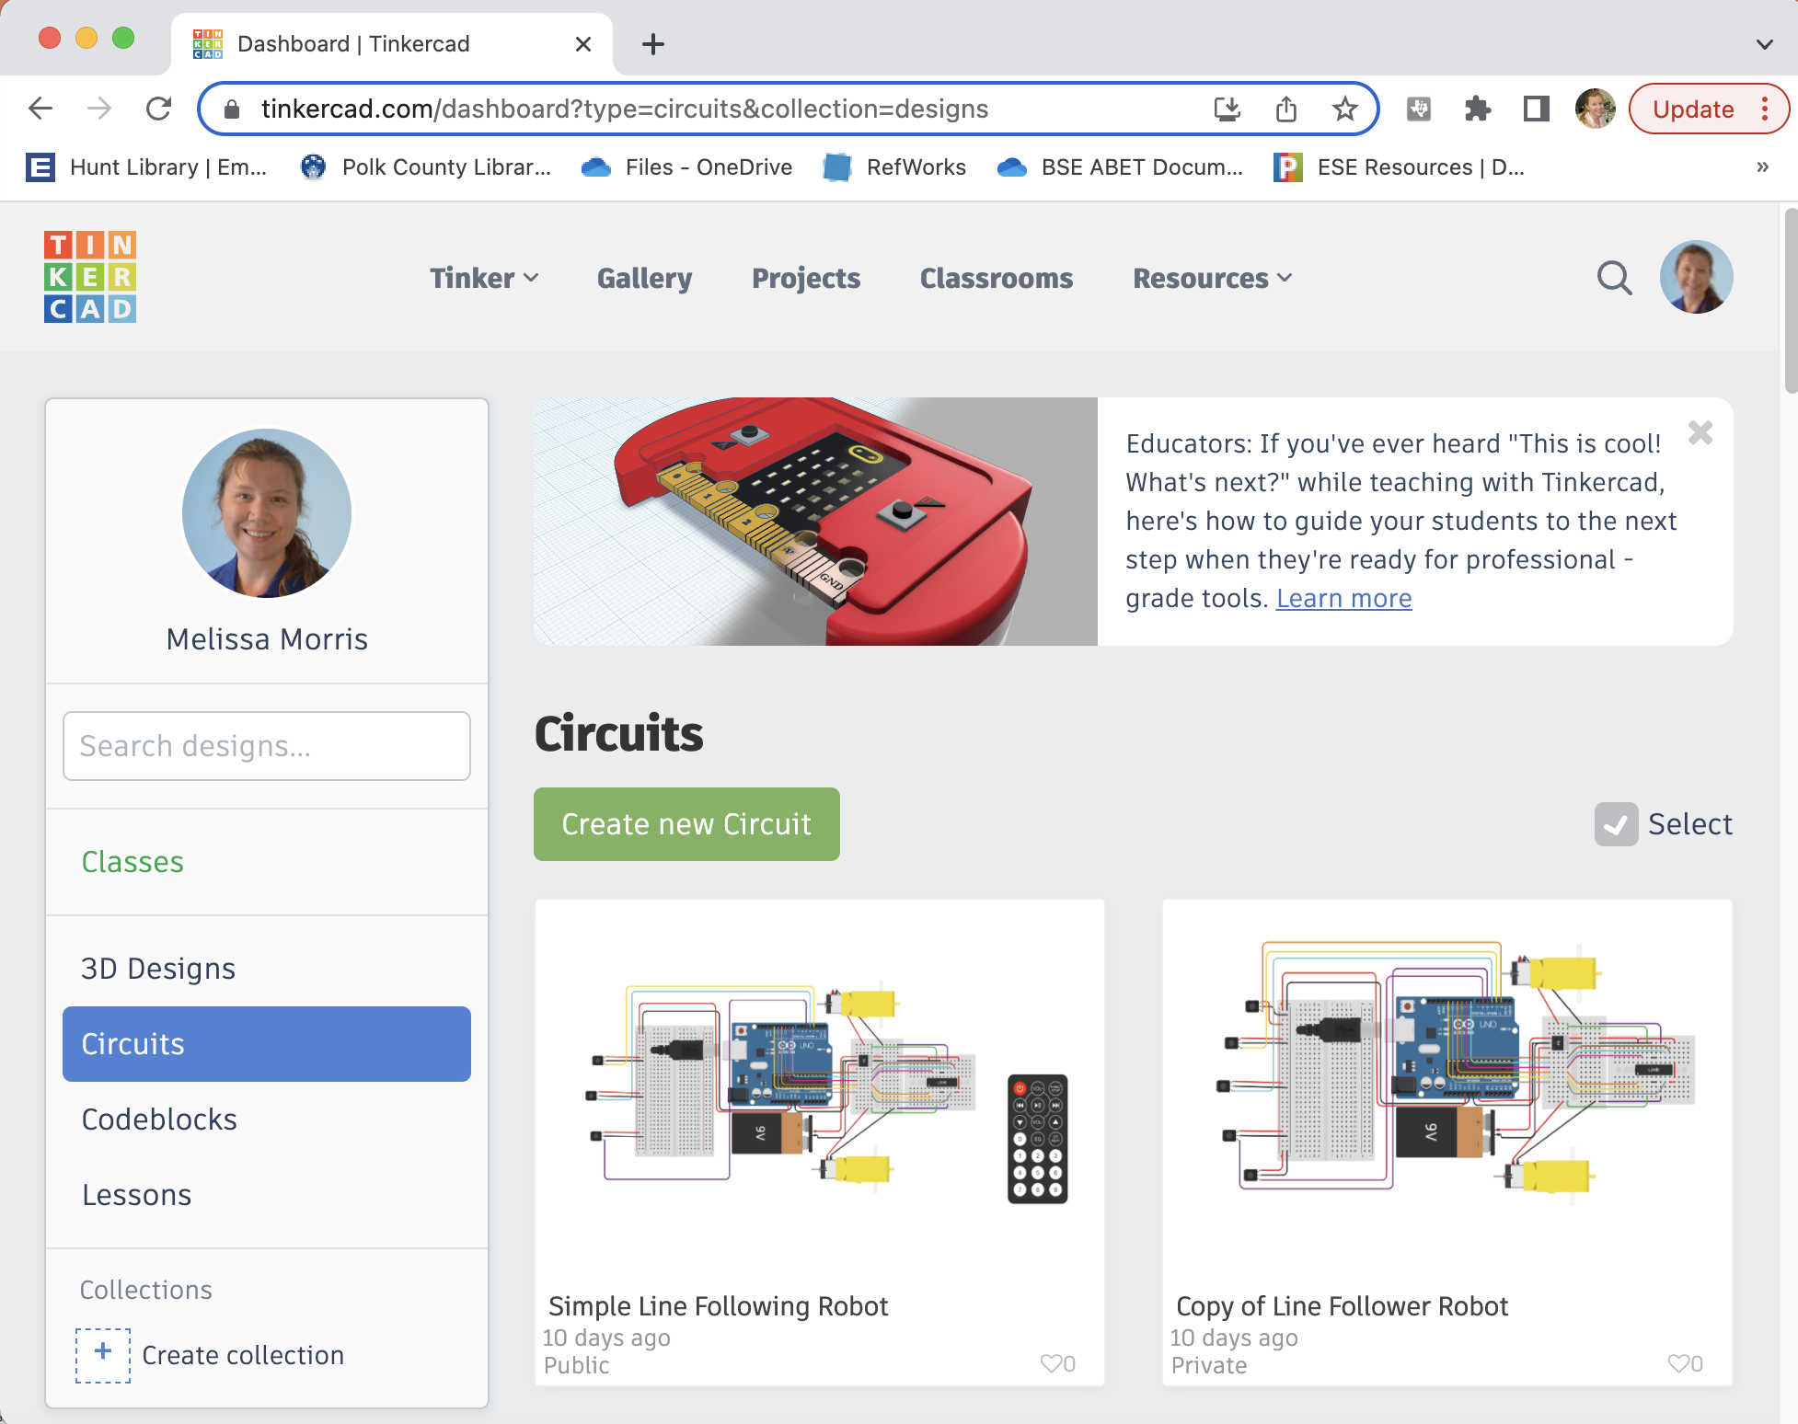
Getting Started

Slide 6
Using The Tool

Slide 7
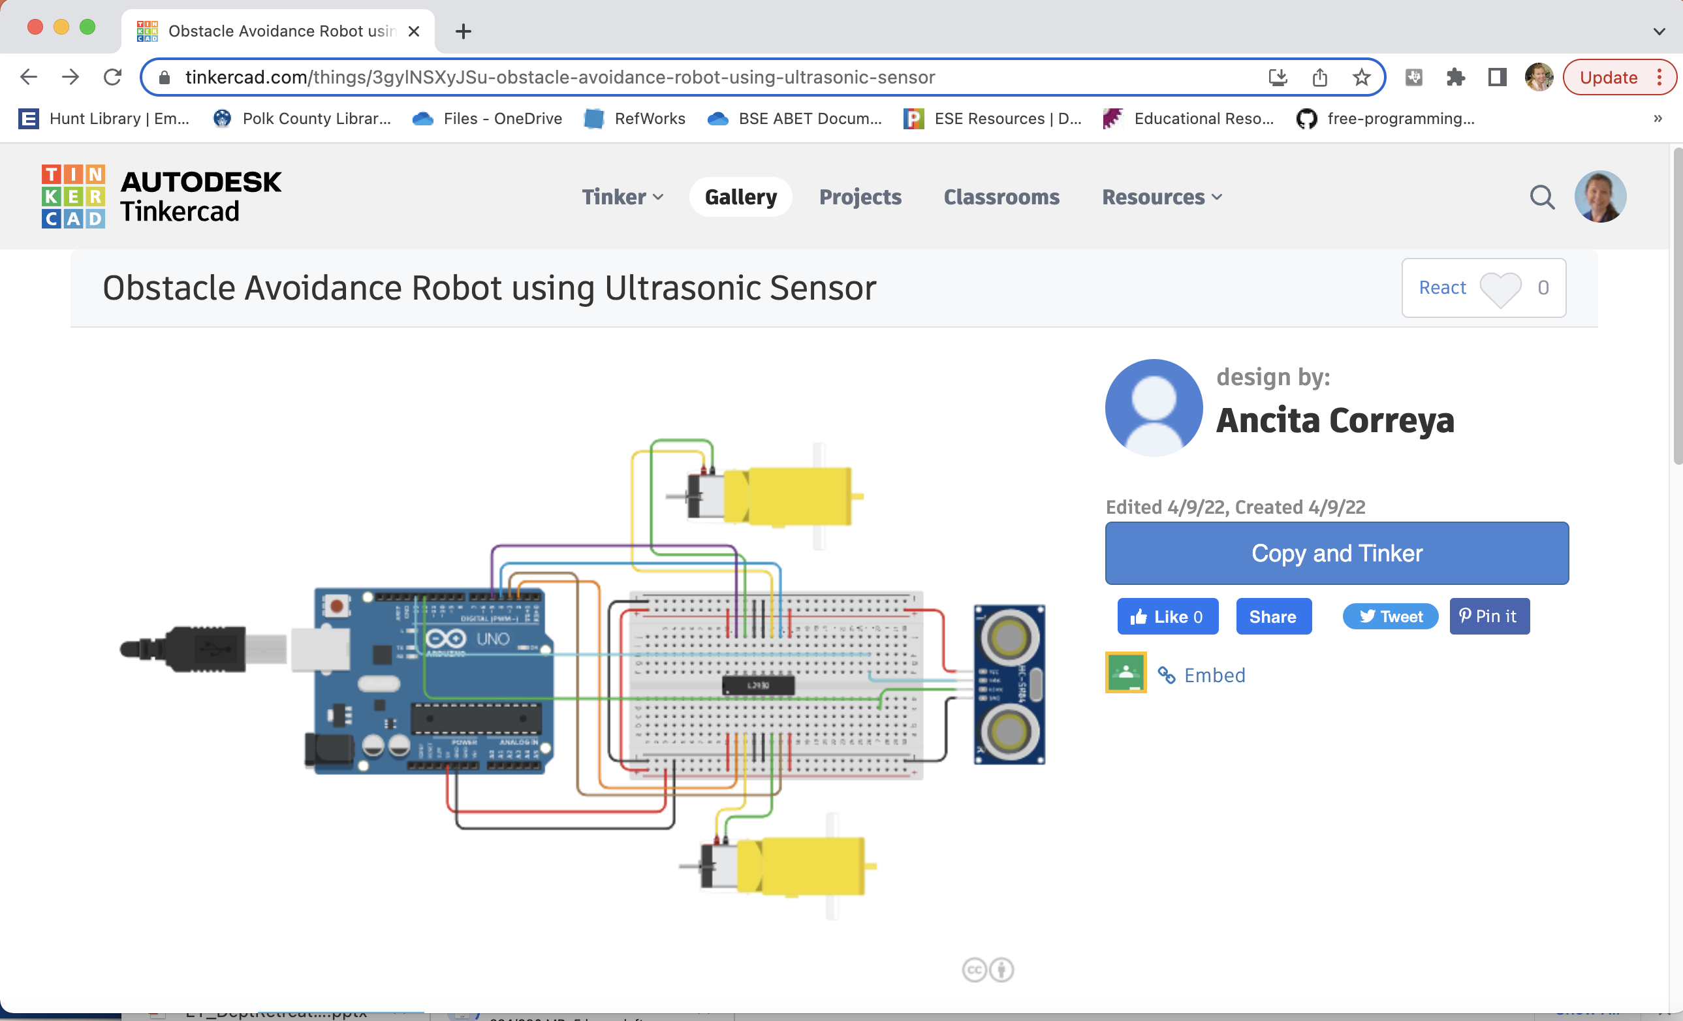
Using Code

Slide 8
Example
https://www.tinkercad.com/things/8lafNpdWJlo-simple-line-following-robot

Slide 9
Activity – Copy and Tinker
Line Follower:
https://www.tinkercad.com/things/8lafNpdWJlo-simple-line-following-robot
Obstacle Avoidance:
https://www.tinkercad.com/things/3gylNSXyJSu-obstacle-avoidance-robot-using-ultrasonic-sensor

Slide 10
morrim44@erau.edu

